Slide 1
Exploring Cryptography Protocols
with Limited Emphasis on Mathematics ☺
Presented By
@7eRoM

Slide 2
Attention
These slides have been crafted using the foundation of my MSc course in Cryptography Protocols at the University of ISfahan.
I've made adjustments to the content to align with the specific objectives of this presentation.
Also, My intention has been to minimize the use of mathematical concepts, which may result in some concepts being simplified or less precise.
Presented By
@7eRoM

Slide 3
Agenda
Identification and Entity Authentications Protocols
Zero Knowledge Protocols
Key Establishment Protocols
Threshold Cryptography and Secret Sharing Protocols
Special Purpose Protocols (like simultaneous contract signing, mental poker, fair exchange)
Identity Based Cryptography
Types of Digital Signatures
Secure Multiparty Computations

Slide 4





Types of Digital Signatures
Warm Up!
Some Beautiful Signatures

Slide 5

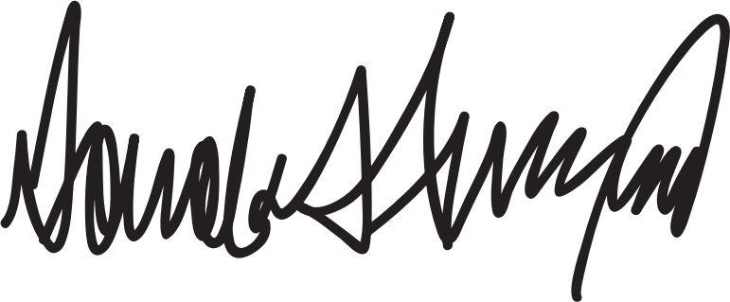
Types of Digital Signatures
Warm Up!
Some Beautiful Signatures

Slide 6
Types of Digital Signatures
Content
Blind Signature
Fail-Stop Signature
Undeniable Signature
Ring Signature (RSA and ECC based)

Slide 7
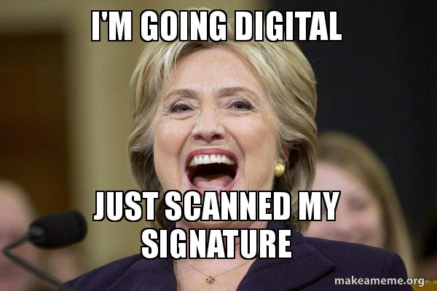
Types of Digital Signatures

Slide 8

Types of Digital Signatures
Blind Signature

Slide 9
Types of Digital Signatures
Blind Signature
The content of what is being signed is not disclosed to the signer.
3 Steps:
Blinding: The requester blinds the original message and sends it to the signer
Signing: The signer signs the blinded message in a manner that is equivalent to signing the original message.
Unblinding: The requester extracts the signed original message from the blinded message.
Abstract Example:
Blinding: The requester places the message inside a carbon paper envelope.
Signing: The signer signs the envelope in a way that the message would be signed.
Unblinding: The requester extracts the signed message from the envelope.

Slide 10


Types of Digital Signatures
Blind Signature – based on RSA
Objective:
Getting m^{d}
Requester
blinding
Signer
X = mr^{e} mod n
public e
private d
ed mod ϕ(n) = 1
r ∈ Z*_{n}
signing
Y = X^{d} mod n
unblinding
Yr⁻¹ mod n
= m^{d} mod n
When an attacker, posing as Alice, sends a previously encrypted message from Bob to him and successfully decrypts it
Yr⁻¹ = X^{d}r⁻¹
= m^{d}r^{ed}r⁻¹
= m^{d}
The usage of each key must be determined.

Slide 11
Types of Digital Signatures
Blind Signature - Usage
Use in e-cash
Objective: Preserve the anonymity of the customer
3 roles:
Customer or Buyer
Salesman or Merchant
Bank: Checks the banknote been spent before?

Slide 12

Types of Digital Signatures
Blind Signature – e-cash
Bank
private random large prime p,q
public n=pq
ed mod ϕ(n) = 1
Database of spent SNs DBx
Only Bank can calculate
1/v mod ϕ(n)
SN of banknote x
value of banknote v
random r
hash function h()
Please deduct v from my balance
B=h(x)r^{v} mod n
Has x been spent before?
D = h(x)^{1/v}r mod n
c = D/r = h(x)^{1/v}
Money (x,c)
D=B^{1/v} mod n
Yes / No
v , (x,c)
Checking to ensure the bank's signature
c^{v} mod n == h(x) mod n

Slide 13
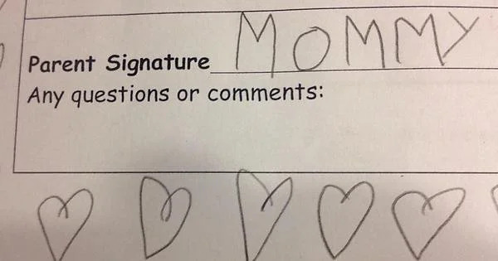
Types of Digital Signatures
Fail-Stop

Slide 14
Types of Digital Signatures
Fail-Stop
If Bob can forge Alice's signature on message m, Alice will be able to prove the forgery.
After the first forgery, all other participants in the system and the system operator know that the signature scheme has been broken, and the system will be stopped.
3 Algorithms:
Signature Generation
Signature Verification
Forgery Proof: Proving the forgery of a signature

Slide 15
Types of Digital Signatures
Fail-Stop – Heyst-Pedersen Scheme
Bank
private s∈Z*_{q}
Alice’s public key h = g^{s} mod p
q | p
private {x₁,x₂,y₁,y₂}
public key p₁ = g^{x1} * h^{x2} mod p
public key p₂ = g^{y1} * h^{y2} mod p
σ₁ = x₁+y₁m mod q
σ₂ = x₂+y₂m mod q
sig(m) = (σ₁,σ₂)
P₁P₂^{m} == g^{σ1}h^{σ2} mod p
g^{σ1}h^{σ2} = g^{x1+y1m} h^{x2+y2m}
= g^{x1} h^{x2} g^{y1m} h^{y2m}
= P₁P₂^{m} mod p

Slide 16
Types of Digital Signatures
Fail-Stop – Heyst-Pedersen Scheme
Imagine the forged signature (σ″₁,σ″₂) on message m′ that passes the verification
Alice tries to calculate Bank’s private s to prove her innocence
private s∈Z*_{q}
Alice’s public key h = g^{s} mod p
private {x₁,x₂,y₁,y₂}
public key p₁ = g^{x1} * h^{x2} mod p
public key p₂ = g^{y1} * h^{y2} mod p
σ₁ = x₁+y₁m mod q
σ₂ = x₂+y₂m mod q
P₁P₂^{m} = g^{σ1}h^{σ2} mod p
For given forged signature: P₁P₂^{m′} = g^{σ″1}h^{σ″2} mod p
Alice calculates his signature on m′: P₁P₂^{m′} = g^{σ′1}h^{σ′2} mod p
g^{σ″1}h^{σ″2} = g^{σ′1}h^{σ′2} mod p
g^{σ″1+sσ″2} = g^{σ′1+sσ′2} mod p
σ″₁+sσ″₂ = σ′₁+sσ′₂ mod q
s = (σ′₁-σ″₁)/(σ″₂-σ′₂) mod q

Slide 17
Types of Digital Signatures
Undeniable Signature
The verification of the signature requires interaction with the signer.
The signer can not deny his signature.
Usage Example
Avoid copying the signature by the other party (like software license)

Slide 18
Types of Digital Signatures
Undeniable Signature - Chaum-Antwerpen Protocol
Signer
Verifier
prime r
prime p=2r+1
public generator g∈Z*_{p}
private key x from range [1,r-1]
public key y=g^{x} mod p
S = sig(m) = m^{x} mod p
C = S^{e1} * y^{e2}
random e₁,e₂ from range [1,r-1]
d = C^{z} mod p
Verify
d == m^{e1} g^{e2}
z = x⁻¹ mod r
⁻¹
m^{e1} g^{e2} = (m^{xe1} g^{xe2})^{x}
= (S^{e1} * y^{e2})^{x}
= C^{z}
⁻¹

Slide 19
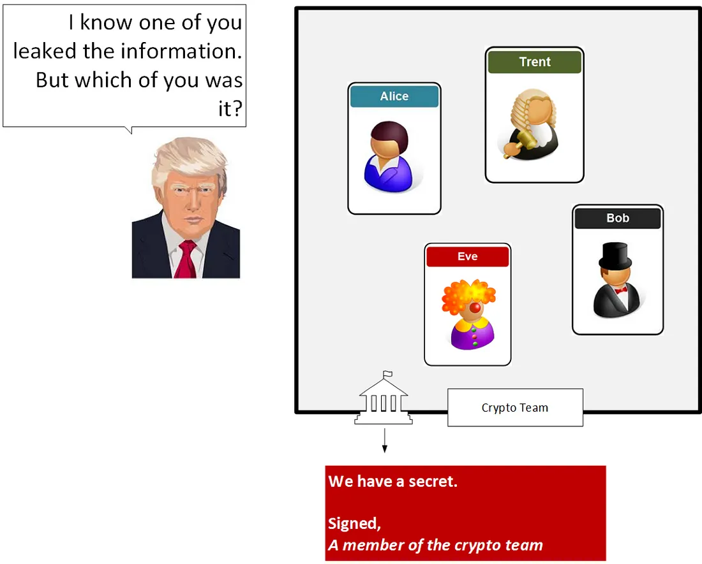
Types of Digital Signatures
Ring Signature
How to leak a secret !?

Slide 20
Types of Digital Signatures
Ring Signature
Suppose Allice knows a secret and wishes to leak it to journalist
BUT Alice wants to remain anonymous!
A standard group signature scheme does not solve the problem, since it requires the prior cooperation of the other group members to set up.
The CryptoNote technology uses ring signatures. It was first implemented by Bytecoin.
ShadowCash: uses traceable ring signature to anonymize the sender of a transaction
Monero: uses ring signatures to obfuscate the true spend in a transaction.

Slide 21

Types of Digital Signatures
Ring Signature

Slide 22
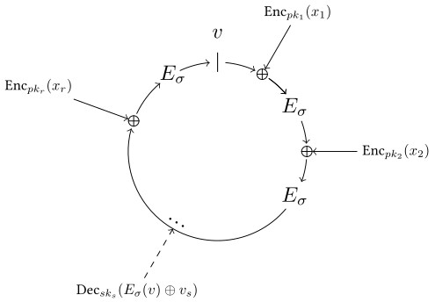
Types of Digital Signatures
Ring Signature – RSA based
Rivest, Shamir, and Tauman (2001)

Slide 23
Types of Digital Signatures
Ring Signature – RSA based
Trapdoor functions
a function that is easy to compute in one direction, yet difficult to compute in the opposite direction (finding its inverse) without special information
In mathematical terms, if f is a trapdoor function, then there exists some secret information t, such that given f(x) and t, it is easy to compute x.

Slide 24
Types of Digital Signatures
Ring Signature – RSA based
Requirements
Each user has public and private key pairs, (P₁, S₁), (P₂, S₂), ..., (P_{n}, S_{n})
A keyed "combining function“ C_{k,v}(y₁,y₂,...,y_{n}) which takes a key k, an initialization value v, and a list of arbitrary value y₁,y₂,...,y_{n}
y_{i} is defined as g_{i}(x_{i}) where g_{i} is a trap-door function
The function C_{k,v}(y₁,y₂,...,y_{n}) is called the ring equation, and is defined below C_{k,v}(y₁,y₂,...,y_{n}) = E_{k}(y_{n} ⊕ E_{k}(y_{n−1} ⊕ E_{k}(y_{n−2} ⊕ E_{k}(... ⊕ E_{k}(y₂ ⊕ E_{k}(y₁ ⊕ v))...))))
Calculate using the signer's private key x_{s} = g_{s}⁻¹(y_{s})

Slide 25
Types of Digital Signatures
Ring Signature – RSA based
Signature Generation
Calculate the key k = H(m) using a cryptographic hash function. m is the message, H is a hash function and k will be used as key for E_{k}
Pick a random glue value v
Pick random x_{i} for all ring members but yourself (x_{s} will be calculated using the signer's private key), and calculate corresponding y_{i} = g_{i}(x_{i})
Solve the ring equation
C_{k,v}(y₁,y₂,...,y_{n}) = E_{k}(y_{n} ⊕ E_{k}(y_{n−1} ⊕ E_{k}(y_{n−2} ⊕ E_{k}(... ⊕ E_{k}(y₂ ⊕ E_{k}(y₁ ⊕ v))...)))) = v
Calculate using the signer's private key x_{s} = g_{s}⁻¹(y_{s})
The ring signature now is the (2n+1)-tuple (P₁ , P₂ ,..., P_{n} ; v ; x₁ , x₂ ,..., x_{n})

Slide 26
Types of Digital Signatures
Ring Signature – RSA based
Signature Verification
Apply the public key trap door on all y_{i} = g_{i}(x_{i})
Calculate the symmetric key k = H(m)
Verify that the ring equation holds C_{k,v}(y₁,y₂,...,y_{n}) = v

Slide 27
Types of Digital Signatures
Ring Signature – ECC based
Setup (Carry out by TA)
Let P be a generator of G
Choose a random number s ∈ Z*_{q} as the master key of TA
Set P_{pub} = sP
Define two cryptographic hash functions H: {0,1}∗ → Z*_{q} and H₁ : {0,1}∗ → G*
The system parameters are params = {G , q , P , P_{pub} , H , H₁}
For given an identity , the corresponding public key is Q_{ID} = H₁(ID) and the private key is S_{ID} = sQ_{ID}
Let L = {ID_{i}}

Slide 28
Types of Digital Signatures
Ring Signature – ECC based
Signature Generation
(Initialization): Choose randomly an element A ∈ G, compute c_{k+1} = H( L ‖ m ‖ e(A,P) )
(Generate forward ring sequence): For i=k+1, ···, n−1, 0, 1, ···, k−1, choose randomly T_{i} ∈ G and compute c_{i+1} = H( L ‖ m ‖ e(T_{i}, P) e(c_{i}H₁(ID_{i}), P_{pub}) )
(Forming the ring): Compute T_{k} = A − c_{k}S_{IDk}
(Output the ring signature): Select 0 (i.e., n) as the glue value, the resulting signature for m and L is the (n+1)-tuple: (c₀, T₀, T₁, ···, T_{n−1})

Slide 29
Types of Digital Signatures
Ring Signature – ECC based
Signature Verification
Compute c_{i+1} = H( L ‖ m ‖ e(T_{i}, P) e(c_{i}H₁(ID_{i}), P_{pub}) ) for i=0, 1, ···, n−1
Accept if c_{n} = c₀, and reject otherwise

Slide 30
Types of Digital Signatures
Ring Signature – ECC based
Signature Verification (Proof)
From the procedure of ring signature generation, we have:
c_{k+1} = H(L ‖ m ‖ e(A, P))
c_{k+2} = H(L ‖ m ‖ e(T_{k+1},P) e(c_{k+1}H₁(ID_{k+1}), P_{pub}))
...
c_{n} = H(L ‖ m ‖ e(T_{n-1},P) e(c_{n-1}H₁(ID_{n-1}), P_{pub})) = c₀
c₁ = H(L ‖ m ‖ e(T₀,P) e(c₀H₁(ID₀), P_{pub}))
c₂ = H(L ‖ m ‖ e(T₁,P) e(c₁H₁(ID₁), P_{pub}))
...
c_{k} = H(L ‖ m ‖ e(T_{k-1},P) e(c_{k-1}H₁(ID_{k-1}), P_{pub}))

Slide 31
Types of Digital Signatures
Ring Signature – ECC based
Signature Verification (Proof)
Since T_{k} = A − c_{k}S_{IDk} , in the procedure of ring signature verification, we have:
c_{k+1} = H( L ‖ m ‖ e(T_{k},P) e(c_{k}H₁(ID_{k}), P_{pub}) )
= H( L ‖ m ‖ e(A − c_{k}S_{IDk},P) e(c_{k}H₁(ID_{k}), P_{pub}) )
= H( L ‖ m ‖ e(A,P) e(−c_{k}S_{IDk},P) e(c_{k}H₁(ID_{k}), P_{pub}) )
= H( L ‖ m ‖ e(A,P) e(−c_{k}H₁(ID_{k}),sP) e(c_{k}H₁(ID_{k}), P_{pub}) )
= H( L ‖ m ‖ e(A,P) e(−c_{k}H₁(ID_{k}) + c_{k}H₁(ID_{k}), P_{pub}) )
= H( L ‖ m ‖ e(A, P) )
The sequence {c_{i}} (i = 0, 1, ···, n−1) in the ring signature verification procedure is the same as the ring signature generation procedure, so we have c_{n} = c₀

Slide 32
Ref
Cryptography Protocols Course, Dr. Hamid Mala, University of Isfahan
“How to Make Efficient Fail-stop-Signatures”, Eugkne van Heyst and Torben Pryds Pedersen
“ID-Based Blind Signature and Ring Signature from Pairings”, Fangguo Zhang and Kwangjo Kim
https://medium.com/asecuritysite-when-bob-met-alice/ring-signatures-and-anonymisation-c9640f08a193
https://en.wikipedia.org/wiki/Ring_signature
https://en.wikipedia.org/wiki/Trapdoor_function
https://delbaraneh.com/
https://www.iconfinder.com/UsersInsights
https://www.iconfinder.com/Chanut-is
https://www.iconfinder.com/iconsets/softwaredemo

